Slide 1
The epithelium: from pathogenesis to the clinic, and the use of biomarkers
Del Dorscheid

Slide 2
Conflicts of interest disclosures
Consultancy / advisory board: AstraZeneca, GSK, Novartis, Sanofi-Regeneron, Valeo
Speaker honoraria: AstraZeneca, Boehringer Ingelheim, GSK, Novartis, Sanofi-Regeneron
Speaker’s bureau: Sanofi, Valeo
Funded grants or clinical trials: AstraZeneca, BC Lung Association, CIHR, GSK
Patents on a drug, product or device: N/A
Employee / role / other: None

Slide 3
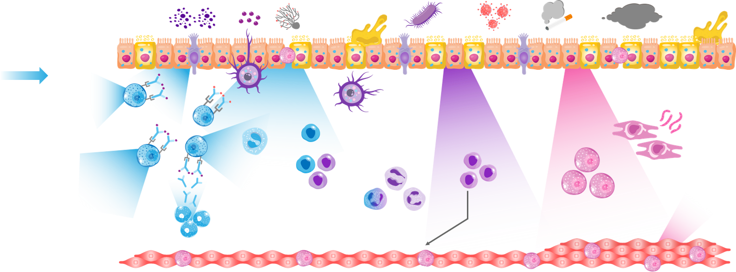
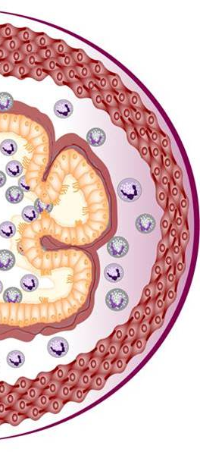
Various cells and inflammatory mediators are involved in asthma pathogenesis^{1–9}
Triggers
Allergens
Cytokines
Fungi
Bacteria
Viruses
Smoke
Pollution
Mucus
Mucus
Epithelium
MUC5
MUC5
Airway
TSLP
IL-33
TSLP
IL-33
IL-25
TSLP
IL-33
IL-25
Tuft cell
TSLP
Mast cell
Goblet cell
IL-5
IL-13
Mast cells
Collagen
Basophil
Dendritic cell
Mucus
Naïve
T cell
IL-13
IL-13
Mast cells
TSLP
ILC2s
Histamine
Leukotrienes
IL-4, IL-13
Th2
cells
TSLP
Fibroblast
IL-5
IL-5
IgE
IL-4, IL-13
ILC2s
B cells
IL-13
Eosinophils
IL-13
IL-13
Smooth muscle
TSLP
IL-6
Mast cell
Allergic eosinophilic
Non-allergic eosinophilic
Beyond-T2 pathways
Figure adapted from Gauvreau GM, et al. Expert Opin Ther Targets 2020;24:777–792. Additional figure adaptations from Davis JD, Wypych TP. Mucosal Immunol 2021;14:978–990
Mechanisms underlying non-eosinophilic inflammation in asthma and the relevance of TSLP in its potential effects on macrophages both require further elucidation. The information presented in this image has been simplified for illustration purposes only and does not imply clinical benefit or relevance
IgE, immunoglobulin E; IL, interleukin; ILC2, type 2 innate lymphoid cell; T2, type 2; Th, T helper; TSLP, thymic stromal lymphopoietin
1. Parnes JR, et al. J Asthma Allergy 2022;15:749–765; 2. Cohn L. J Clin Invest 2006;116:306–308; 3. Brusselle GG, Koppelman GH. N Engl J Med 2022;386:157–171; 4. Janeway CA, et al. Immunobiology: The Immune System in Health and Disease. 5th edition. New York: Garland Science; 2001. Glossary. Available from: https://www.ncbi.nlm.nih.gov/books/NBK10759/; 5. Davis JD, Wypych TP. Mucosal Immunol 2021;14:978–990; 6. Brightling CE, et al. N Engl J Med 2002; 346:1699–1705; 7. Begueret H, et al. Thorax 2007;62:8–15;
8. Krystel-Whittemore M, et al. Front Immunol 2016;6:620; 9. Gao H, et al. J Immunol Res 2017;2017:3743048
Notes:
Figure adapted from Gauvreau GM, Sehmi R, Ambrose CS, et al. Thymic stromal lymphopoietin: its role and potential as a therapeutic target in asthma. Expert Opin Ther Targets 2020 Aug;24(8):777–792. Additional figure adaptations from Davis JD, Wypych TP. Cellular and functional heterogeneity of the airway epithelium. Mucosal Immunol 2021 Sep;14(5):978–990
Parnes JR, Molfino N, Colice G, et al. Targeting TSLP in asthma. J Asthma Allergy 2022 Jun 3;15:749–765
Cohn L. Mucus in chronic airway diseases: sorting out the sticky details. J Clin Invest 2006 Feb 1;116(2):306–308
Brusselle GG, Koppelman G. Biological therapies for severe asthma. N Engl J Med 2022 Jan 13;386(2):157–171
Janeway CA, Travers P, Walport M, et al. Immunobiology: The Immune System in Health and Disease. 5th edition. New York: Garland Science; 2001. Glossary. Available from: https://www.ncbi.nlm.nih.gov/books/NBK10759/
Davis JD, Wypych TP. Cellular and functional heterogeneity of the airway epithelium. Mucosal Immunol 2021 Sep;14(5):978–990
Brightling CE, Bradding P, Symon F, et al. Mast-cell infiltration of airway smooth muscle in asthma. N Engl J Med 2002 May 30; 346(22):1699–1705
Begueret H, Berger P, Vernejoux J, et al. Inflammation of bronchial smooth muscle in allergic asthma. Thorax 2007 Jan;62(1):8–15
Krystel-Whittemore M, Dileepan K, Wood J. Mast cell: A multi-functional master cell. Front Immunol 2016 Jan 6;6:620
Gao H, Ying S, Dai Y. Pathological Roles of Neutrophil-Mediated Inflammation in Asthma and Its Potential for Therapy as a Target. J Immunol Res 2017;2017:3743048

Slide 4



Patients may have multiple drivers of inflammation and overlapping phenotypes^{1–6}
Patients may display overlapping inflammatory pathways, which may change over time owing to different circumstances,
such as changes in medications, treatment adherence, exacerbations or exposure to allergens^{1–4}
Overlap of baseline positivity of three clinically used biomarkers from the International Severe Asthma Registry (N=1,175)⁵
The UK Severe Asthma Registry assessed patients (N=2,225) attending
15 specialist severe asthma centres.⁶ In this cohort:
Blood eosinophils positive
Median blood eosinophils was 0.33 cells/10⁹L
Triple biomarker negative: 12%
8%
Median FeNO was 39 ppb
14%
8%
27%
7%
10%
14%
Median IgE level of 181 IU/mL
FeNO positive
IgE
positive
Figure adapted from Denton E, et al. J Allergy Clin Immunol Pract 2021;9:2680–8
Further work is needed to address the complexity of severe asthma, as suboptimal control continues to impact patient outcomes and quality of life^{1,7}
FeNO, fractional exhaled nitric oxide; IgE, immunoglobulin E; IU, international unit; ppb, parts per billion
1. Busse WW. Allergol Int 2019;68:158–66; 2. Tran TN, et al. Ann Allergy Asthma Immunol 2016;116:37–42; 3. Price D, Canonica G. World Allergy Organ J 2020;13:100380; 4. Kupczyk M, et al. Allergy 2014;69:1198–204; 5. Denton E, et al.
J Allergy Clin Immunol Pract 2021;9:2680–88; 6. Jackson DJ, et al. Thorax 2021;76:220–27; 7. Park S-Y, et al. Allergy Asthma Immunol Res 2022;14:447–464
Notes:
Figure adapted from Denton E, Price DB, Tran TN, et al. Cluster analysis of inflammatory biomarker expression in the international severe asthma registry. J Allergy Clin Immunol Pract 2021 Jul;9(7):2680–88
Busse WW. Biological treatments for severe asthma: A major advance in asthma care. Allergol Int 2019 Apr;68(2):158–66
Tran TN, Zeiger R, Peters S, et al. Overlap of atopic, eosinophilic, and TH2-high asthma phenotypes in a general population with current asthma. Ann Allergy Asthma Immunol 2016 Jan;116(1):37–42
Price D and Canonica G. Biomarker relatability in the International Severe Asthma Network. World Allergy Organ J 2020 Aug 20;13(8):100380
Kupczyk M, Dahlén B, Sterk P, et al. Stability of phenotypes defined by physiological variables and biomarkers in adults with asthma. Allergy 2014 Sep;69(9):1198–204
Denton E, Price D, Tran T, et al. Cluster analysis of inflammatory biomarker expression in the international severe asthma registry. J Allergy Clin Immunol Pract 2021 Jul;9(7):2680–88
Jackson DJ, Busby J, Pfeffer P, et al. Characterisation of patients with severe asthma in the UK Severe Asthma Registry in the biologic era. Thorax 2021 Mar;76(3):220–27
Park S-Y, Kang S-Y, Song W-J, et al. Evolving concept of severe asthma: transition from diagnosis to treatable traits. Allergy Asthma Immunol Res 2022 Sep;14(5):447–464

Slide 5
Multiple inflammatory pathways underpin the complexity and heterogeneity of inflammation in asthma^{1–4}
Asthma-associated inflammation is complex and heterogenous,^{1–3} with numerous cell types and downstream immune pathways involved^{1,4}
Asthma phenotyping integrates clinical and biological disease characteristics,⁵ including triggers of inflammation, clinical signs and pathological features⁶
There are three prominent phenotypes of asthma, which may overlap considerably:
Allergic eosinophilic asthma^{1,2,4,7}
Triggers: perennial aeroallergens
Characterised by: high serum IgE,
high eosinophils and high FeNO biomarker levels
Non-allergic eosinophilic asthma^{1,2,4,7}
Triggers: pathogens, pollutants
and smoke
Characterised by: high blood eosinophils and high FeNO biomarker levels
Beyond T2 asthma^{4,8}
Triggers: pathogens, pollutants
and smoke
Characterised by: mechanistic effects, such as airway hyperresponsiveness and mucus production
FeNO, fractional exhaled nitric oxide; IgE, immunoglobulin E; T2, Type 2
1. Busse WW. Allergol Int 2019;68:158–66; 2. Tran TN, et al. Ann Allergy Asthma Immunol 2016;116:37–42; 3. Carr TF, Bleecker E. World Allergy Organ J 2016;9:41; 4. Gauvreau GM, et al. Expert Opin Ther Targets 2020;24:777–792;
5. Chung KF, et al. Eur Respir J 2014;43:343–73; 6. Ijaz HM, et al. Cureus 2019;11:e4194; 7. Porsbjerg CM, et al. Eur Respir J 2020;56:2000260; 8. Hudey SN, et al. Curr Opin Immunol 2020;66:123–28
Notes:
Busse WW. Biological treatments for severe asthma: A major advance in asthma care. Allergol Int 2019 Apr;68(2):158–66
Tran TN, Zeiger R, Peters S, et al. Overlap of atopic, eosinophilic, and TH2-high asthma phenotypes in a general population with current asthma. Ann Allergy Asthma Immunol 2016 Jan;116(1):37–42
Carr TF, Bleecker E. Asthma heterogeneity and severity. World Allergy Organ J 2016 Nov 29;9(1):41
Gauvreau GM, Sehmi R, Ambrose C, et al. Thymic stromal lymphopoietin: its role and potential as a therapeutic target in asthma. Expert Opin Ther Targets 2020 Aug;24(8):777–792
Chung KF, Wenzel S, Brozek J, et al. International ERS/ATS guidelines on definition, evaluation and treatment of severe asthma. Eur Respir J 2014 Feb;43(2):343–73
Ijaz HM, Chowdhury W, Lodhi M, et al. A case of persistent asthma resistant to available treatment options: management dilemma. Cureus 2019 Mar;11(3):e4194
Porsbjerg CM, Sverrild A, Lloyd C, et al. Anti-alarmins in asthma: targeting the airway epithelium with next-generation biologics. Eur Respir J 2020 Nov 12;56(5):2000260
Hudey SN, Ledford D, Cardet J. Mechanisms of non-type 2 asthma. Curr Opin Immunol 2020 Oct;66:123–28

Slide 6
Managing asthma is challenging because airway inflammation is complex, heterogeneous and dynamic^{1–3}
Patients can have concurrent overlapping pathways,
and their dominant pathway can change over time^{1–3}
100
Cluster 1 (low EOS, high NEU)
Cluster 2 (low EOS, low NEU)
Cluster 3 (high EOS, high NEU)
Cluster 4 (high EOS, low NEU)
In a study investigating phenotype stability
based on sputum
testing, ~50%
of patients with severe
asthma changed their biomarker profile over
1 year of follow up²
90
80
70
60
Patients (%)
50
40
Phenotype change
(based on biomarkers*)
in full cohort (included patients with mild/moderate and severe asthma; n=52)²
30
20
10
0
Baseline
After 1 year of follow up
Movement between clusters (some patients changed cluster;
some patients remained in the same cluster)
*EOS high: ≥2%; NEU high: ≥40% in induced sputum
EOS, eosinophils; NEU, neutrophils
1. Tran TN, et al. Ann Allergy Asthma Immunol 2016;116:37–42; 2. Kupczyk M, et al. Allergy 2014;69:1198–204; 3. Busse WW. Allergol Int 2019;68:158–66
Notes:
Tran TN, Zeiger R, Peters S, et al. Overlap of atopic, eosinophilic, and TH2-high asthma phenotypes in a general population with current asthma. Ann Allergy Asthma Immunol 2016 Jan;116(1):37–42
Kupczyk M, Dahlén B, Sterk P, et al. Stability of phenotypes defined by physiological variables and biomarkers in adults with asthma. Allergy 2014 Sep;69(9):1198–204
Busse WW. Biological treatments for severe asthma: A major advance in asthma care. Allergol Int 2019 Apr;68(2):158–66

Slide 7
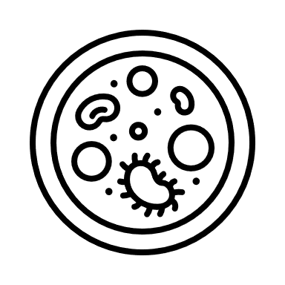


Clinical evaluations for asthma^{1–6}
Asthma biomarkers
Test for changes at the cellular level
Validated biomarkers
Additional tests
Eosinophils^{1,2}
FeNO¹
Sputum induction²
IgE²
CRP⁴
Airway hyperresponsiveness⁷
Aspergillus antigens³
ANCA and ANA^{5,6}
ANA, antinuclear antibodies; ANCA, antineutrophilic cytoplasmic antibodies; CRP, C-reactive protein; FeNO, fractional exhaled nitric oxide; IgE, immunoglobulin E
1. Wan XC, Woodruff PG. Immunol Allergy Clin North Am 2016:36;547–557; 2. Kim H, et al. Allergy Asthma Clin Immunol 2017;13:48; 3. Sisodia J, Bajaj T. Allergic bronchopulmonary aspergillosis. In: StatPearls. Treasure Island (FL): StatPearls Publishing, 2023. Available from: http://www.ncbi.nlm.nih.gov/books/NBK542329/ (Accessed 17 July); 4. Ong LT. EMJ Allergy and Immunology 2021;6:53–60; 5. Emmi G, et al. Nat Rev Rheumatol 2023;19:378–393; 6. Grygiel-Górniak B, et al. Reumatologia 2017;55:298–304; 7. Sverrild A, et al. Respir Res 2021;22:87
Notes:
Wan XC, Woodruff PG. Biomarkers in severe asthma. Immunol Allergy Clin North Am 2016 Aug:36(3);547–557
Kim H, Ellis A, Fischer D, et al. Asthma biomarkers in the age of biologics. Allergy Asthma Clin Immunol 2017 Nov 17;13:48
Sisodia J, Bajaj T. Allergic Bronchopulmonary Aspergillosis. [Updated 2023 Feb 28]. In: StatPearls [Internet]. Treasure Island (FL): StatPearls Publishing; 2023 Jan. Available from: https://www.ncbi.nlm.nih.gov/books/NBK542329/
Ong LT. High-sensitivity assays for C-reactive protein as a systemic inflammatory marker in assessing asthma. EMJ Allergy and Immunology 2021;6:53–60
Emmi G, Bettiol A, Gelain E, et al. Evidence-based guideline for the diganosis and management of eosinophilic granulomatosis with polyangiitis. Nat Rev Rheumatol 2023 Jun;19(6):378–393
Grygiel-Górniak B, Rogacka N, Rocacki M, et al. Antinuclear antibodies in autoimmune and allergic diseases. Reumatologia 2017;55(6):298–304
Sverrild A, Leadbetter J, Porsbjerg C. The use of the mannitol test as an outcome measure in asthma intervention studies: a review and practical recommendations. Respir Res 2021;22:87

Slide 8
Validated and experimental biomarkers and the asthma phenotypes they can be used to identify^{1,2}
Biomarker | Allergic eosinophilic asthma | Non-allergic eosinophilic asthma | Beyond-T2 asthma
Eosinophils¹ | ↑ | ↑
IgE¹ | ↑
FeNO² | ↑ | ↑
Other validated and experimental biomarkers can also be used to identify asthma phenotypes¹
Notes:
Kim H, Ellis A, Fischer D, et al. Asthma biomarkers in the age of biologics. Allergy Asthma Clin Immunol 2017 Nov 17;13:48
Ricciardolo FL, Sorbello V, Ciprandi G. A pathophysiological approach for FeNO: A biomarker for asthma. Allergol Immunopathol (Madr) 2015 Nov–Dec;43(6):609–616

Slide 9
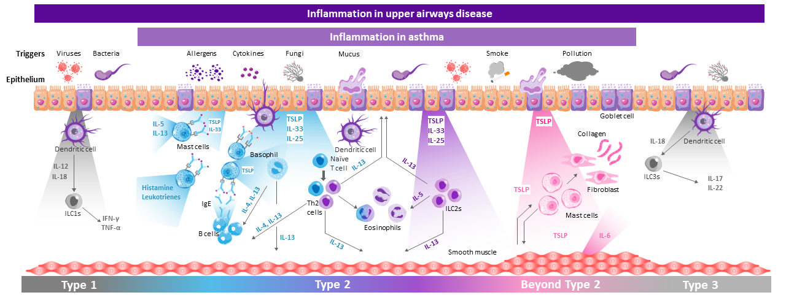
Similar inflammatory processes are associated with both upper and lower airways diseases^{1–6}
Figure adapted from Porsbjerg CM, et al. Eur Respir J 2020;56:2000260, Gauvreau GM, et al. Expert Opin Ther Targets 2020;24:777–792 and Fokkens WJ, et al. Rhinology 2020;58(Suppl S29):1–464
Mechanisms underlying non-eosinophilic inflammation in asthma and the relevance of TSLP in its potential effects on macrophages both require further elucidation. The information presented in this image has been simplified for illustration purposes only and does not imply clinical benefit or relevance.
IFN, interferon; IgE, immunoglobulin E; IL, interleukin; ILC, innate lymphoid cell; Th, T helper; TNF, tumour necrosis factor; TSLP, thymic stromal lymphopoietin
1. Yii AC, et al. Allergy 2018;73:1964–1978; 2. Laulajainen-Hongisto A, et al. Front Cell Dev Biol 2020;8:204; 3. Fokkens W, Reitsma S. Otolaryngol Clin North Am 2023;56:1–10; 4. Parnes JR, et al. J Asthma Allergy
2022;15:749–765; 5. Fokkens WJ, et al. Rhinology 2020;58(Suppl S29):1–464; 6. Victor AR, et al. J Immunol 2017;199:2333–2342
Notes:
Figure adapted from Porsbjerg CM, Sverrild A, Lloyd C, et al. Anti-alarmins in asthma: targeting the airway epithelium with next-generation biologics. Eur Respir J 2020 Nov 12;56(5):2000260, Gauvreau GM, Sehmi R, Ambrose CS, et al. Thymic stromal lymphopoietin: its role and potential as a therapeutic target in asthma. Expert Opin Ther Targets 2020 Aug;24(8):777–792 and Fokkens WJ, Lund V, Hopkins C, et al. European Position Paper on Rhinosinusitis and Nasal Polyps 2020. Rhinology 2020 Feb 20;58(Suppl S29):1–464
Yii AC, Tay T-R, Choo X, et al. Precision medicine in united airways disease: A "treatable traits" approach. Allergy 2018 Oct;73(10):1964–1978
Laulajainen-Hongisto A, Toppila-Salmi S, Luukainen A, et al. Airway epithelial dynamics in allergy and related chronic inflammatory airway diseases. Front Cell Dev Biol 2020 Mar 27;8:204
Fokkens W, Reitsma S. Unified airway disease: A contemporary review and introduction. Otolaryngol Clin North Am 2023 Feb;56(1):1–10
Parnes JR, Molfino N, Colice G, et al. Targeting TSLP in asthma. J Asthma Allergy 2022 Jun 3;15:749–765
Fokkens WJ, Lund V, Hopkins C, et al. European Position Paper on Rhinosinusitis and Nasal Polyps 2020. Rhinology 2020 Feb 20;58(Suppl S29):1–464
Victor AR, Nalin A, Dong W, et al. IL-18 drives ILC3 proliferation and promotes IL-22 production via NF-κB. J Immunol 2017 Oct 1;199(7):2333–2342

Slide 10
Diagnostic tools and biomarkers in upper airway diseases^{1–4}
Current biomarkers may demonstrate the presence of T2 disease; however, their clinical utility beyond this remains unclear^{1–3}
Other potentially promising techniques include examination of tissue biopsies, determination of cytokine levels in nasal lavage fluid, and nasal cytology^{1,4}
  Nasal cytology provides insight into inflammatory infiltration
  in the nasal mucosa, which has allowed for the identification
  of specific pathologies in rhinitis and chronic rhinosinusitis⁵
Further research into biomarkers and other diagnostic tools, which allow for upper airway disease to be accurately subtyped, may lead to improved outcomes for patients^{3,4}
Currently available biomarkers include:^{1–3}
Blood eosinophils
Total
serum IgE
Allergen-specific IgE
IgE, immunoglobulin E; T2, type 2
1. Bousquet J, et al. Nat Rev Dis Primers 2020;6:95; 2. Fokkens W, Reitsma S. Otolaryngol Clin North Am 2023;56:1–10; 3. Miglani A, et al. Otolaryngol Clin North Am 2023;56:11–22; 4. Heffler E, et al. Clin Exp Allergy 2018;48:1092–1106; 5. Caruso C, et al. Front Allergy 2022;3:768408
Notes:
Bousquet J, Anto J, Bachert C, et al. Allergic rhinitis. Nat Rev Dis Primers 2020 Dec 3;6(1):95
Fokkens W, Reitsma S. Unified airway disease: a contemporary review and introduction. Otolaryngol Clin North Am 2023 Feb;56(1):1–10
Miglani A, Brar T, Lal D. Unified airway disease: surgical management. Otolaryngol Clin North Am 2023 Feb;56(1):11–22
Heffler E, Landi M, Caruso C, et al. Nasal cytology: methodology with application to clinical practice and research. Clin Exp Allergy 2018 Sep;48(9):1092–1106
Caruso C, Giancaspro R, Guida G, et al. Nasal Cytology: A Easy Diagnostic Tool in Precision Medicine for Inflammation in Epithelial Barrier Damage in the Nose. A Perspective Mini Review. Front Allergy 2022 Apr 6;3:768408

Slide 11
Allergic and non-allergic rhinitis represent heterogenous conditions associated with significant disease burden^{1,2}
Subtypes | Allergic rhinitis | Nonallergic rhinitis
Effector cells | Eosinophil, mast cell, basophil, B cell, Th2 cell³ | Eosinophil, ILC2, mast cell^{5,6}
Primary biomarkers | IgE, FeNO, periostin, PGD2 signalling³ | –
Clinical features | Nasal obstruction, rhinorrhea, sneezing, loss of smell, nasal/palatal itch^{2,4} | Nasal obstruction, rhinorrhea, sinus headaches, post-nasal drip^{2,4}
35–50% of patients may have an overlap of allergic and nonallergic rhinitis^{2*}
Novel, reliable biomarkers to phenotype and endotype patients
with rhinitis are needed for the improvement of patient care^{2,7}
*Based on a study of 656 patients with a physician diagnosis of allergic rhinitis (n=404), mixed rhinitis (n=129) or non-allergic rhinitis (n=123)²
FeNO, fractional exhaled nitric oxide; ILC, innate lymphoid cell; IgE, immunoglobulin E; PGD2, prostaglandin 2; Th, T helper
1. Hellings PW, et al. Allergy 2017;72:1657–1665; 2. Greiwe JC, Bernstein JA. J Clin Med 2019;8:2019; 3. Breiteneder H, et al. Allergy 2020;75:3039–3068; 4. Fokkens WJ, et al. Rhinology 2020;58:1–464; 5. Yii AC, et al. Allergy 2018;73:1964–1978; 6. Heffler E, et al. Clin Exp Allergy 2018;48:1092–1106; 7. Bousquet J, et al. Nat Rev Dis Primers 2020;6:95
Notes:
Hellings PW, Klimek L, Cingi C, et al. Non-allergic rhinitis: Position paper of the European Academy and Clinical Immunology. Allergy 2017 Nov;72(11):1657–1665
Greiwe JC, Bernstein JA. Allergic and Mixed Rhinitis: Diagnosis and Natural Evolution. J Clin Med 2019 Nov 19;8(11):2019
Breiteneder H, Peng Y-Q, Agache I, et al. Biomarkers for diagnosis and prediction of therapy responses in allergic diseases and asthma. Allergy 2020 Dec;75(12):3039–3068
Fokkens WJ, Lund V, Hopkins C, et al. European Position Paper on Rhinosinusitis and Nasal Polyps 2020. Rhinology 2020 Feb 20;58:1–464
Yii A, Tay T-R, Choo X, et al. Precision medicine in united airways disease: A “treatable traits” approach. Allergy 2018 Oct;73(10):1964–1978
Heffler E, Landi M, Caruso C, et al. Nasal cytology: methodology with application to clinical practice and research. Clin Exp Allergy 2018 Sep;48(9):1092–1106
Bousquet J, Anto J, Bachert C, et al. Allergic rhinitis. Nat Rev Dis Primers 2020 Dec 3;6(1):95

Slide 12
CRSwNP represents heterogeneous, and often overlapping, endotypes^{1–4}
Endotypes | TYPE 1 | TYPE 2 | TYPE 3
Effector cells | M1 macrophage, CD8+ T cell, Th1 cell, ILC1, NK cell² | M2 macrophage, eosinophil, basophil, Th2 cell, ILC2, mast cell² | Neutrophil, Th17 cell, ILC3²
Primary cytokines | IFN-γ, IL-12² | IL-4, IL-5, IL-13² | IL-17, IL-22²
Clinical features | Headache / facial pain^{3,4} | Smell loss High clinical burden Asthma comorbidity^{2–4} | Purulent rhinorrhea^{2–4}
Despite a growing focus on endotypes in CRSwNP,
many patients cannot be categorised to a single endotype^{3,4}
Approximately 26–63% of patients with CRSwNP show evidence of having a mixed endotype,
while 9% show no detectable endotype based on current biomarkers^{3,4}
CD, cluster of differentiation; CRSwNP, chronic rhinosinusitis with nasal polyps; IFN, interferon; IL, interleukin; ILC, innate lymphoid cell; IL, interleukin; NK, natural killer; Th, T helper
1. Tomassen P, et al. J Allergy Clin Immunol 2016;137:1449–1456; 2. Staudacher AG, et al. Ann Allergy Asthma Immunol 2020;124:318–325; 3. Hao D, et al. J Inflamm Res 2022;15:5557–5565; 4. Stevens WW, et al. J Allergy Clin Immunol Pract 2019;7:2812–2820
Notes:
Tomassen P, Vandeplas G, Van Zele T, et al. Inflammatory endotypes of chronic rhinosinusitis based on cluster analysis of biomarkers. J Allergy Clin Immunol 2016;137(5):1449–1456
Staudacher AG, Peters A, Kato A, et al. Use of endotypes, phenotypes, and inflammatory markers to guide treatment decisions in chronic rhinosinusitis. Ann Allergy Asthma Immunol 2020 Apr;124(4):318–325
Hao D, Wu Y, Li P, et al. An Integrated analysis of inflammatory endotypes and clinical characteristics in chronic rhinosinusitis with nasal polyps. J Inflamm Res 2022 Sep 24;15:5557–5565
Stevens WW, Peters A, Tan B, et al. Associations between inflammatory endotypes and clinical presentations in chronic rhinosinusitis. J Allergy Clin Immunol Pract 2019 Nov–Dec;7(8):2812–2820

Slide 13
Summary
Biomarkers such as eosinophils, IgE and FeNO can be used to interrogate the complexity of the epithelium
in asthma, and relate to the state of the epithelium and epithelial-derived cytokines^{1,2}
Currently available biomarkers for upper airway diseases include blood eosinophils, total serum IgE and
allergen-specific IgE; such biomarkers may demonstrate the presence of T2 disease^{3–5}
Expansion of validated biomarker panels may aid in the phenotyping of both upper and lower airway diseases^{6,7}
Understanding the united pathology of upper and lower airway diseases suggests that a united approach
to disease management may be needed to achieve global disease control for patients⁸
FeNO, fractional exhaled nitric oxide; IgE, immunoglobulin E; T2, type 2
1. Denton E, et al. J Allergy Clin Immunol Pract 2021;9:2680–88; 2. Porsbjerg CM, et al. Eur Respir J 2020;56:2000260; 3. Bousquet J, et al. Nat Rev Dis Primers 2020 3;6:95; 4. Fokkens W, Reitsma S. Otolaryngol Clin North Am 2023;56:1–10; 5. Miglani A, et al. Otolaryngol Clin North Am 2023;56:11–22; 6. Liu X, et al. Clin Transl Disc 2021;1:e11; 7. Kicic A, et al. J Allergy Clin Immunol 2020;145:1562–1573; 8. Licari A, et al. Front Pediatr 2017;5:44
Notes:
Denton E, Price B, Tran T, et al. Cluster analysis of inflammatory biomarker expression in the international severe asthma registry. J Allergy Clin Immunol Pract 2021 Jul;9(7):2680–88
Porsbjerg CM, Sverrild A, Lloyd C, et al. Anti-alarmins in asthma: targeting the airway epithelium with next-generation biologics. Eur Respir J 2020 Nov 12;56(5):2000260
Bousquet J, Anto J, Bachert C, et al. Allergic rhinitis. Nat Rev Dis Primers 2020 Dec 3;6(1):95
Fokkens W, Reitsma S. Unified airway disease: a contemporary review and introduction. Otolaryngol Clin North Am 2023 Feb;56(1):1–10
Miglani A, Brar TK, Lal D. Unified airway disease: surgical management. Otolaryngol Clin North Am 2023 Feb;56(1):11–22
Liu X, Cui B, Wang Q, et al. Biomarkers for respiratory diseases: present applications and future discoveries. Clin Transl Disc 2021;1:e11
Kicic A, de Jong E, Ling K-M, et al. Assessing the unified airway hypothesis in children via transcriptional profiling of the airway epithelium. J Allergy Clin Immunol 2020;145:1562–1573
Licari A, Castagnoli R, Denicolò CF, et al. The nose and the lung: united airway disease? Front Pediatr 2017 Mar 3;5:44

